Slide 1


Beyond
Buzz Words
Establishing Organizational Infrastructure to Advance Health Equity in a Local Public Health Department
Dr. Kimberly Scott
Assistant Health Director, Population Health
Notes:
I am excited to be here; first Cure MD conference! Our team is excited to join the cure md community (go live date Nov 2023)

Slide 2
Today We Will…
Define Health Equity
Describe MCPH’s process for identifying most underserved populations
Describe MCPH’s organizational restructure to Advance Equity
Discuss MCPH’s Departmental Equity Action Team
Review MCPH’s approach to equitable investments in marginalized and underserved communities
Describe evaluation and data improvement planning efforts

Slide 3

Health Equity
What’s the buzz about?

Slide 4

What is
Health Equity?
Health equity means that everyone has a fair opportunity to be as healthy as possible. This requires removing systemic obstacles to health like poverty, discrimination, and their consequences, including powerlessness and lack of access to good jobs with fair pay, quality education and housing, healthy food options, safe environments, and health care.”
Adapted from RWJ definition

Slide 5
“Health is a human right, and no one should be excluded from enjoying this right.”
Nelson Mandela

Slide 6
Mecklenburg County
Overview
AGE DISTRIBUTION
TOTAL POPULATION
1,122,276
MEDIAN AGE
2021 5 year average
35.4
RACIAL/ETHNIC COMPOSITION
MEDIAN HOUSEHOLD INCOME
2017-2021
$73,124
*Non-Hispanic.
**Other includes American Indian, Native Hawaiian, Pacific Islanders, and Persons choosing Other as a Race.

Slide 7
Vulnerable Populations
Groups at greater risk for health problems, poor access to care and more likely to experience health inequities
Examples of vulnerable populations identified through the 2022 Mecklenburg County Community Health Assessment include but are not limited to:
  Black/African American Adults, Chronic Disease, Maternal & Child Health
  Latino/Hispanic Adults Who Speak English as Second Language, Access to Care
  Youth/Young Adults, Violence Prevention & Mental Health

Slide 8
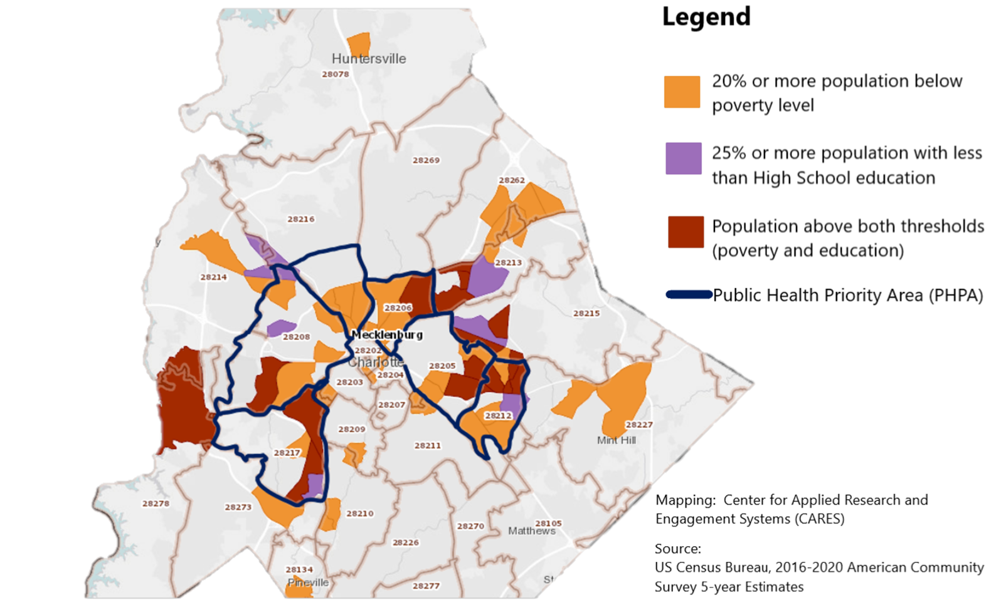
Vulnerable Populations

Slide 9
What does it look and feel like to advance health equity?
No significant differences in health outcomes between populations
Social Determinants of health addressed (e.g. housing)
Access to high-quality care for everyone
Ongoing data collection and monitoring
Authentic community engagement
Equitable funding allocation
Collaboration across sectors

Slide 10
“Real change starts with recognizing that we are a part of the systems we seek to change.”
Peter Senge

Slide 11

Organizational Restructure
Population Health Division
Office of
Health Equity
Office of
Chronic Disease
Policy & Prevention
Office of Violence Prevention
Division
Initiatives
Aims to support, develop, and implement innovative equity-centered policies, practices, and programs that improve overall health and quality of life for all Mecklenburg County residents by eliminating disparities between historically underserved populations

Slide 12
Organizational Restructure
Office of Health Equity
Community
Engagement & Strategic Partnerships
Community Health Worker Initiative
Improving Community Outcomes 4 Maternal and Child Health (ICO4MCH)
Village HeartBEAT
Aims to reduce disparities and eliminate disparities in disease, death rates, and quality of life among identified vulnerable and historically underserved populations.

Slide 13
Workforce Investments to Advance Equity
Workforce Development Initiative
Latino/Hispanic Engagement
Community Health Workers

Slide 14

Workforce Development Initiative
  Deploy CDC Grant Funding, Strengthening U.S. Public Health Infrastructure, Workforce, and Data Systems, to enhance equitable Public Health workforce
  Sustain and expand Public Health Educators onboarded to support COVID-19 mitigation efforts
  Design and implement trauma-informed staff practices

Slide 15

Latino/Hispanic Engagement
  Hire and sustain staff to coordinate Latino/Hispanic Engagement efforts
  Expand Latino/Hispanic engagement efforts by developing a workforce reflective of community
  Conduct Latino/Hispanic gap analysis to inform organizational strategic direction
  Create communication network to enhance engagement with Latino workforce and grassroots leaders

Slide 16

Community Health Workers
  Establish backbone infrastructure to support community health workers (CHW), and agencies that employ them
  Convene CHW Coalition (QC Community Connect Coalition) to:
    nurture workforce and professional development opportunities
    increase public and professional recognition of community health worker expertise and contribution
    equip CHWs with relevant resources by sharing active health and social services that serve Mecklenburg County communities
  Engage senior leadership from organizations who employ community health workers to ensure coordination, alignment,

Slide 17
“Not everything that is faced can be changed, but nothing can be changed until it is faced.”
James Baldwin

Slide 18

Departmental Equity Action Team (DEAT) Overview
The DEAT is a volunteer committee dedicated to the advancement of equity within the Mecklenburg County Public Health department through strengthened internal policies, practices, program delivery, and services.

Slide 19
DEAT Roles & Responsibilities
Serve as departmental equity ambassador​s
Support the design and implementation of the MCPH Departmental Equity Action Plan​
Provide resources, guidance, and technical assistance to peers seeking to enhance equitable practices​
Recommend employee training opportunities and tools to advance the Department's culture of equity​
Work to resolve issues rooted in bias and discrimination through research, education, and partnerships​
Build partners/alliances to promote equity and inclusion within MCPH

Slide 20
DEAT Organizational Assessment & Planning
Purpose
Develop a baseline understanding of where the Department stands internally on important diversity, equity and inclusion (DEI) indicators to assess how well the Department is doing in certain areas and where there are opportunities for growth in other areas
Objective
Use assessment results to inform the DEAT’s ongoing work in finalizing the development and implementation of a Departmental EAP that is responsive to the Department’s needs and aspirations regarding DEI

Slide 21
“Equality is leaving the door open for anyone who has the means to approach it; equity is ensuring there is a pathway to that door for those who need it.”
Caroline Belden

Slide 22
Equitable Investments
Increase minority and women-led vendors to support organizational operations
Provide funding opportunities for grassroots organizations through grants aligned with core public health priority areas of focus
Provide capacity strengthening resources to advance fiscal development of grassroots organizations
Sustain grassroot Community Advisory Network for bidirectional learning and engagement

Slide 23

How do internal improvements drive community change?

Slide 24
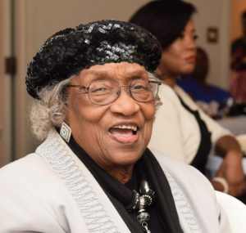
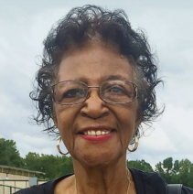
Acknowledge the Past to Build the Future
Thereasea Clark Elder
Madie Maddax Smith-Moore

Slide 25

How is the advancement of “health equity” measured when the concept is not universally defined?

Slide 26
Equitable Data and Evaluation
Establish core population health indicators to guide division-wide work and measure population health status
Strengthen organizational capacity to implement consistent evaluation practices to understand, improve, and account for population health actions
Democratize population health data through dynamic dashboards and user-friendly community platforms
Expand creative nontraditional data collection methodologies to articulate population health outcomes through stories and lived experience

Slide 27
What’s Next?
Explore opportunities to utilize electronic health records to further advance health equity (CureMD go live date November 2023!)
Assess results of organizational equity assessment and launch full equity plan implementation
Incorporate results of Latino/Hispanic gap analysis into strategic planning

Slide 28
“Design is not just what it looks like and feels like. Design is how it works.”
Steve Jobs

Slide 29

From Buzz to Business: Lessons Learned
Educate Yourself/ Asses your bias
Consistently review organizational practices with feedback from core stakeholders
Advocate for improved policies, practices, programs and workflows
Authentically engage with populations proximal to issues to identify strategic direction and progress
Democratize data to enhance transparency and trust
Stay Committed-Equity is a journey, not a destination!

Slide 30
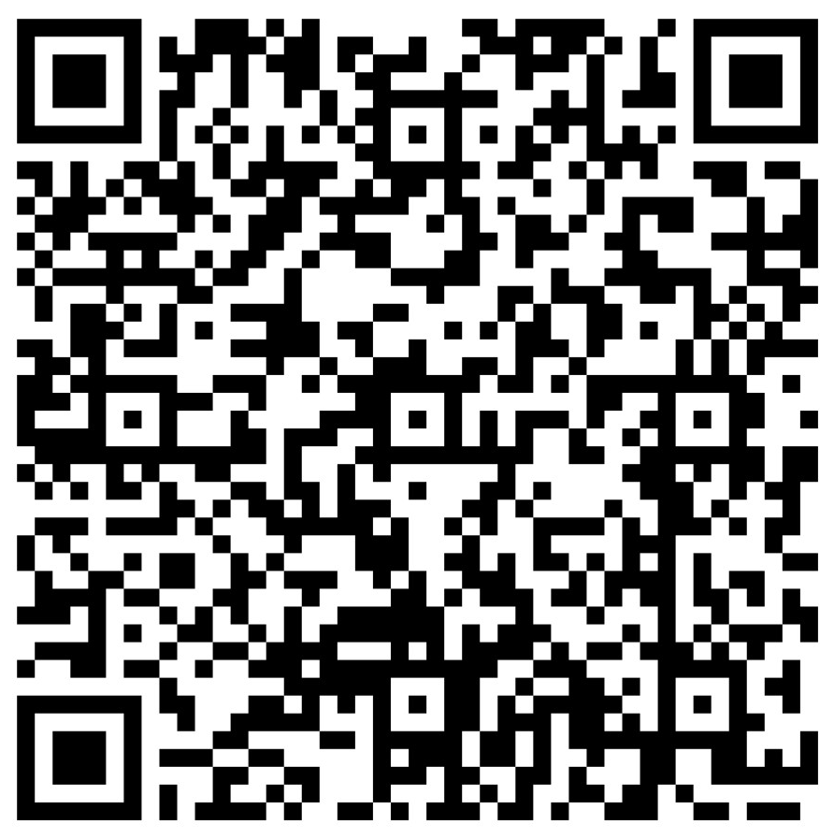
Resources & Reads
Podcasts
Health Equity Matters
Citations Needed
Just Health Care
Code Switch
Decolonize First
Health Equity Heroes
TED Talks
Our Approach to Health Is Broken. Here’s How to Fix It, Dr. Atul Gawande
How Racism Makes Us Sick, David R. Williams
The Lies We Tell Pregnant Women, Sofia Jawed-Wessel
How to fix a broken education system… without any more money, Seema Bansal
How to make hospitals less deadly, Atul Gawande
Books
Medical Apartheid: The Dark History of Medical Experimentation on Black Americans from Colonial Times to the Present, Harriet A. Washington
The Deepest Well: Healing the Long-Term Effects of Childhood Adversity, Dr. Nadine Burke Harris
Just Medicine: A Cure for Racial Inequality in American Health Care, Dr. Dayna Bowen Matthew
The Immortal Life of Henrietta Lacks, Rebecca Skloot
Health Disparities and Intellectual Disabilities, edited by Eric Emerson and Chris Hatton
Latinx: The New Force in American Politics and Culture, Ed Morales
The Political Determinants of Health, Daniel E. Dawes
Share your favorites with the group!

Slide 31
Questions

Slide 32
“Together we will always rise.”
T’Challa, Black Panther

Slide 33

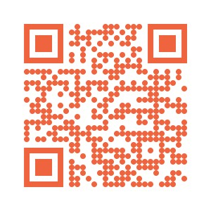

Let’s Connect!
Email: kimberly.scott2@mecknc.gov

